Slide 1
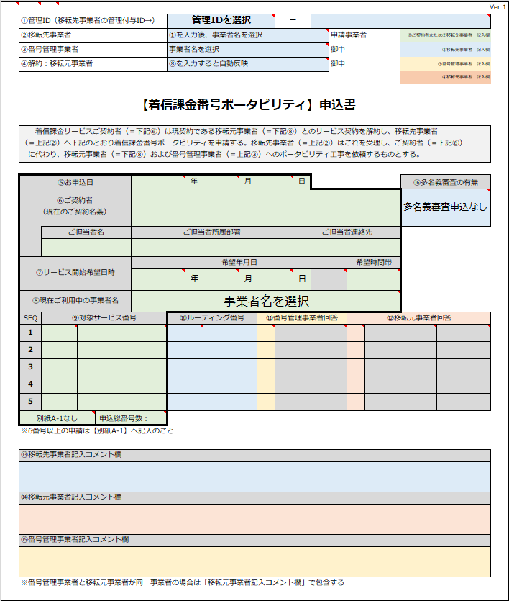
Number portability application form (Sample)
REMINDERS! Read before proceeding
Do not make any edits in the format
Do not save in another file type
Only fill out the sections as instructed in this slide

Slide 2
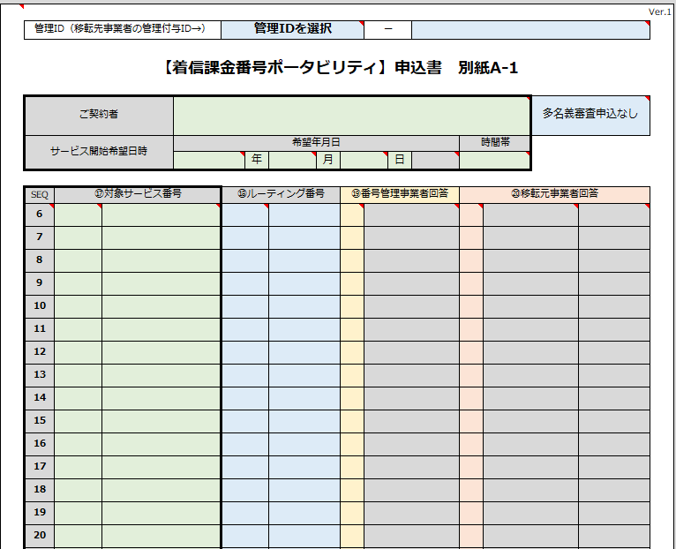
For port requests with more than 5 numbers
Utilize the second page and input numbers 6th till 20th.
We only allow 20 numbers per request.

Slide 3
How to fill out - Fields 1 to 4
No. | Items | Description and Attention points
(1) | ⑤Date of application | Use the dropdown options. Format is YYYY MM DD
(2) | ⑥Name of owner, based on who is written in the contract | Name of the number owner. Any minor discrepancy, typographical error will automatically cause the port approval to fail. Please ensure information is exactly as what is in your contract.
(3) | ・Contact phone number ・Name of department in charge ・Name of person in charge | Contact details for communication between telecom carriers/SB and E/U (if required, E/U’s contact info.)
(4) | ⑦Preferred port date and time | Due to the nature of process, we do not allow preferred date and time. You may however select if you prefer port to be done in the Morning Window (9 AM to 12 PM JST ) or Afternoon Window (1 AM to 6 PM JST). Take note that this is a window and we do not have the ability to choose a specific hour/time. Select 午前 for Morning, 午後 for Afternoon. In the case of accidentally choosing the wrong option, Twilio will not take responsibility and it is important to understand that this will be the customer’s responsibility to choose the correct option.
(1)
(2)
(3)
(4)
(5)
(6)

Slide 4
Continuation, fields 5 to 6
(5) | ⑧Name of the current telecom carrier | Select from the dropdown menu.
(6) | ⑨Porting-in target numbers | Select prefix 0800 or 0120 from the dropdown menu and fill in the other digits of the numbers to be ported.
(1)
(2)
(3)
(4)
(5)
(6)

